Slide 1
PS/2
Julio César Almada Fuerte
A00226046
ITE

Slide 2
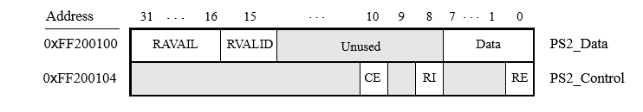
The DE10 includes PS/2 ports on which you can connect a keyboard or mouse. The port includes a 256-byte FIFO that stores data received from a PS/2 device.
PS2_Data register is both readable and writable, when RVALID is 1, Reading from it provides the data at the head of the FIFO in the Data field. The number of entries in the FIFO are written into the RAVAIL field.
PS2_Control register can be used to enable interrupts from the PS/2 port by setting the RE field to 1.

Slide 3
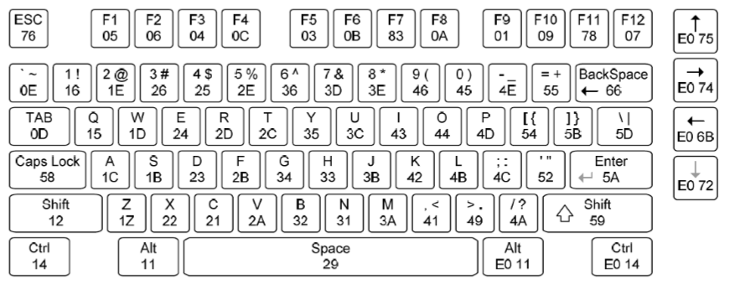
Keyboard scan codes in Hex

Slide 4
PS/2 Program using a keyboard
Make a program on which each Key pressed is displayed on the 7-segment displays by their scan code.

Slide 5
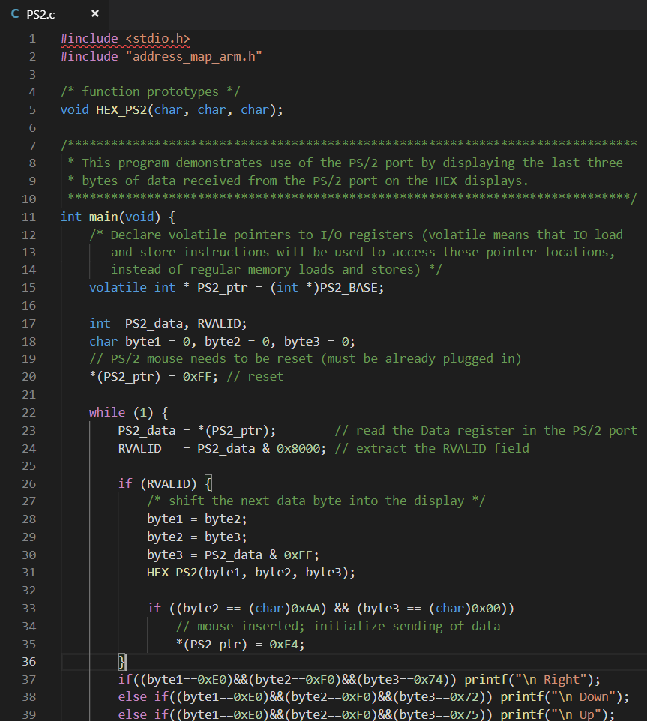

Slide 6
